Slide 1
A Seminar on DFFMD-A DEEPFAKE FACE MASK DATASET FOR INFECTIOUS DISEASE ERA WITH DEEPFAKE DETECTION ALGORITHMS
Team Details
Team No-1
1. Ch.Sweekruthi Reshma (21EG505810)
2. L.Sreepadh (21EG505845)
3. T.Meghanath (21EG505865)
Project Supervisor
Mrs.B.Ujwala
Assistant Professor

Slide 2
Introduction
The recent growth of technology in computer-generated editing programs has made synthesizing and modifying media content easier than ever. The potential for misinformation spread has exploded, especially with the phenomenon known as Deepfake. Deepfake is a technology that uses deep learning to create fake videos, alter existing videos, or even synthesize the speech of someone’s voice. This makes it a dangerous tool in malicious applications of spreading fake news and disseminating false or dangerous information. Therefore, developing digital forensic deep learning models and algorithms to detect fakes is more critical for digital security than ever.

Slide 3
Problem Statement
The rise of deepfake technology poses a significant threat to various aspects of society, enabling the creation of fake images and videos with synthesized or replaced faces. This phenomenon has become more pronounced and challenging due to the widespread use of face masks, particularly since the onset of the infectious disease outbreak in 2020.
Face masks obstruct defining facial features, making it increasingly difficult to identify and distinguish between authentic and synthetic content. This situation raises concerns about the potential malicious use of deepfakes

Slide 4
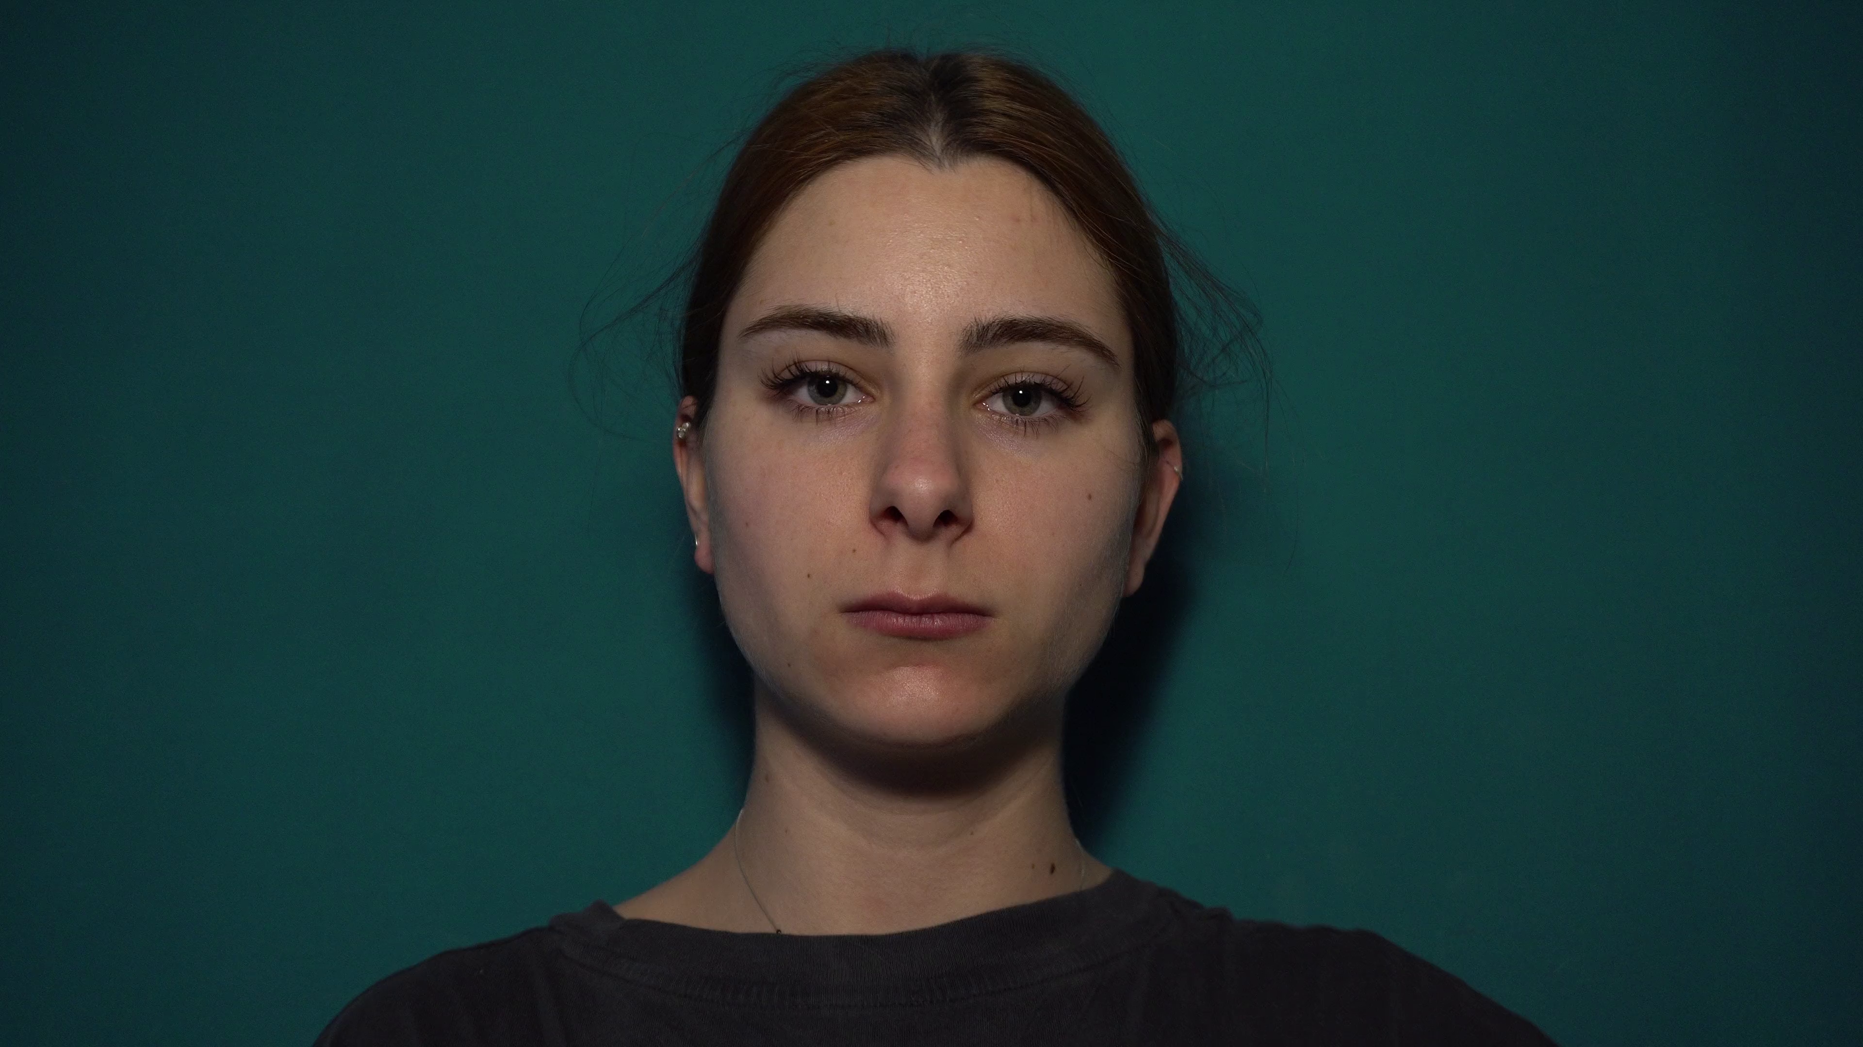
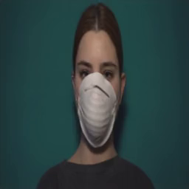
Problem Illustration
REAL
FAKE

Slide 5
Proposed Method
The proposed system tackles the escalating societal concern of deepfakes through innovative methodologies. Introducing the Deepfake Face Mask Dataset (DFFMD) and leveraging a novel Inception-ResNet-v2 approach, augmented with preprocessing stages, feature-based analysis, residual connections, and batch normalization, the research significantly enhances the accuracy of deepfake video detection amidst face masks—filling a critical gap left by conventional methods.
The investigation delves into various deep learning models, including VGG19, CNN, and an extended Xception architecture, showcasing a comprehensive exploration of techniques for combating deepfake threats. This multifaceted approach establishes a robust foundation for advanced deepfake detection, crucial in mitigating the adverse impacts of falsified content in an era dominated by evolving digital challenges.

Slide 6
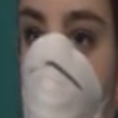
Proposed Method Illustration
When we upload the video the video will break down in to different angle of frames and those each frame is processed by the model and will predict whether the video is Real or Fake.

Slide 7
Experiment Environment
Tools:
Anaconda
Sqlite
Jupyter Notebook
Language:
Python
Dataset:
The dataset is collected from kaggle which is the first dataset with a face mask in the field of DeepFake. We can use the dataset to predict whether the video of a person wearing a face mask is a deepfake or not.

Slide 8
Experiment Environment
Libraries: Tensorflow, Keras, cv2, numpy, matplotlib
Tensorflow & Keras: TensorFlow and Keras, often used synonymously for deep learning tasks, are employed to build and train sign language recognition models. Model architectures are then designed using Keras, with TensorFlow as the backend, usually involving Convolutional Neural Networks(CNNs) for image recognition.
cv2: OpenCV (Open Source Computer Vision Library) is a popular library for computer vision and image processing tasks. It is used for capturing video frames, image manipulation, and drawing on images. In this code, it's used for capturing video from the camera, resizing images, and displaying images with annotations.
Numpy: NumPy is a fundamental library for numerical operations in Python. It's commonly used for array and matrix manipulation. In this code, it's used for various mathematical calculations and creating arrays.
Matplotlib: Matplotlib is a popular library in Python for creating static, interactive visualizations and plots.

Slide 9
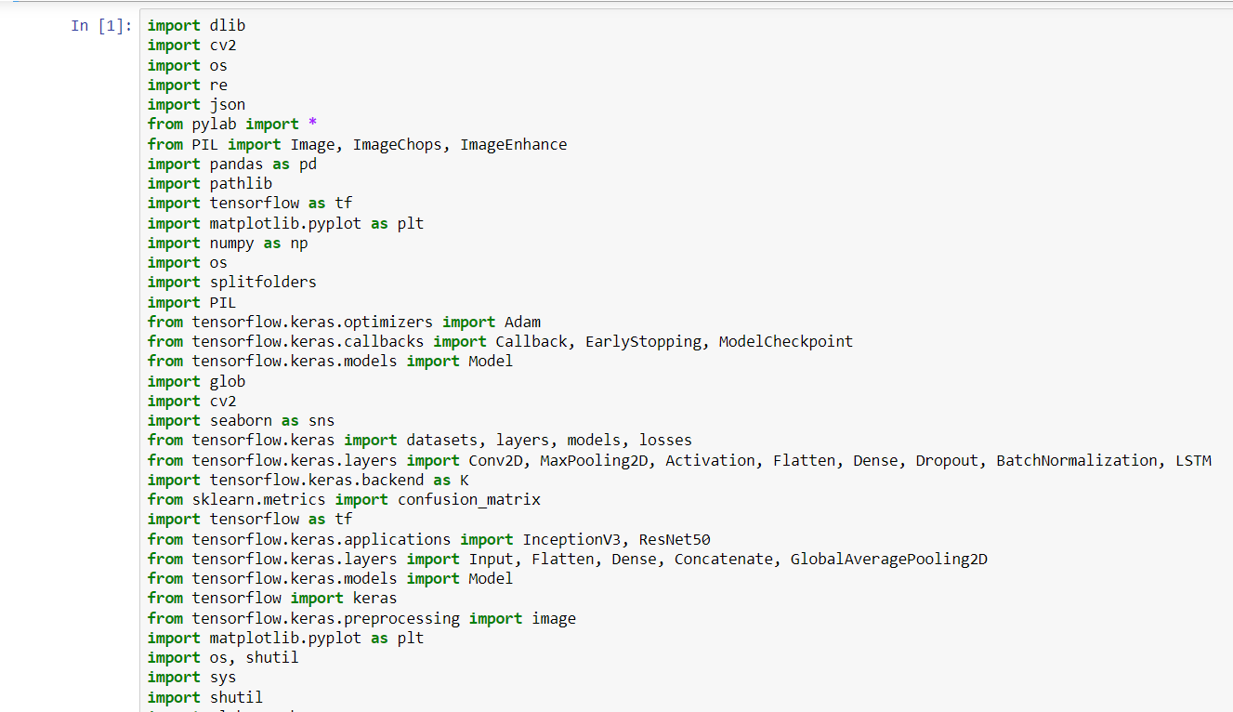
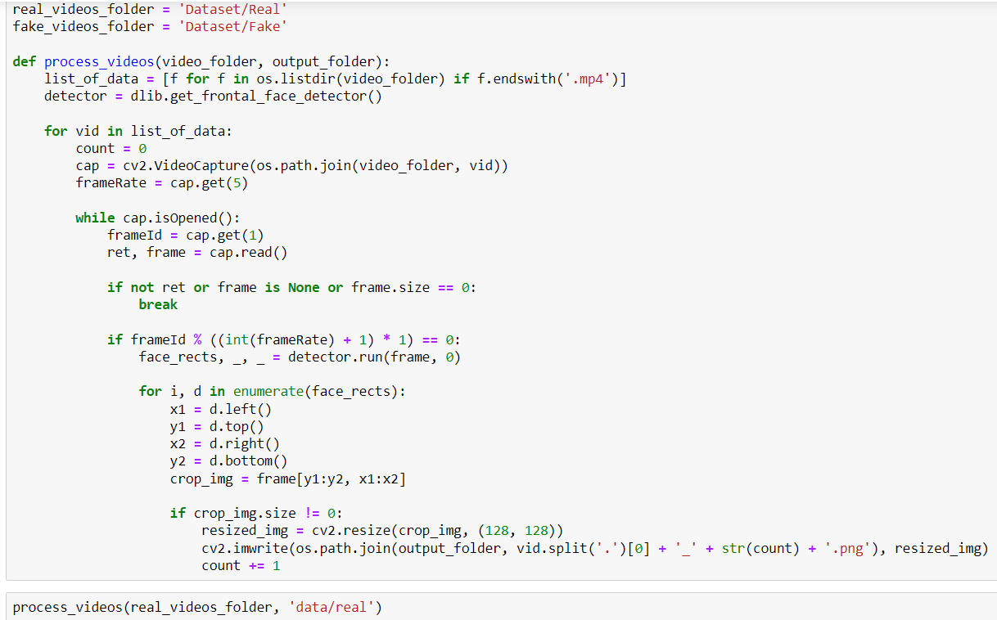
Experiment Screenshots

Slide 10
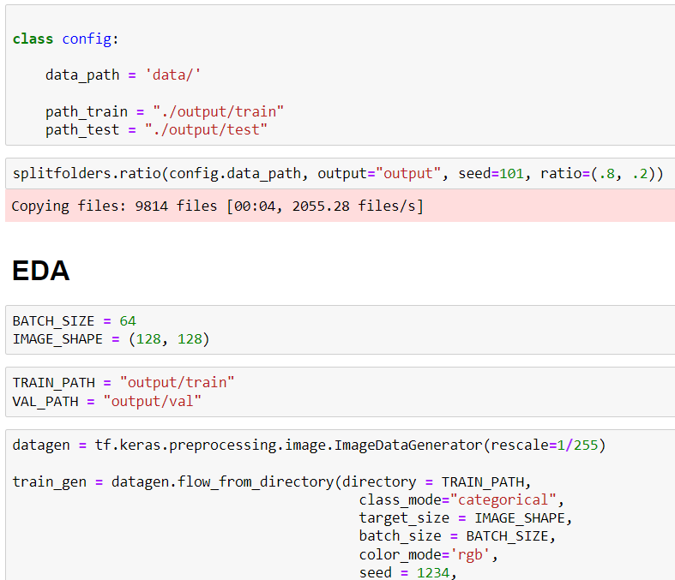
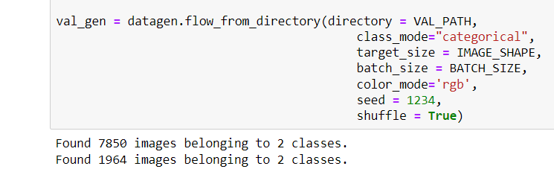
Experiment Screenshots

Slide 11
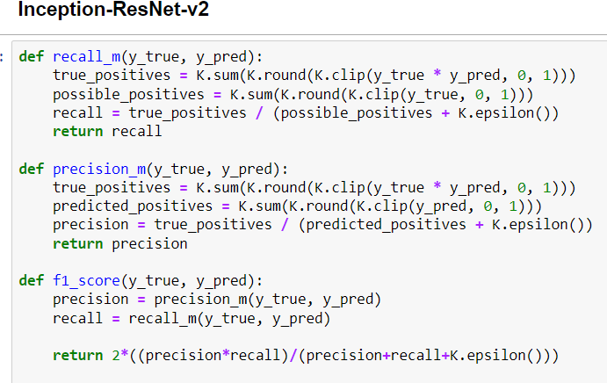
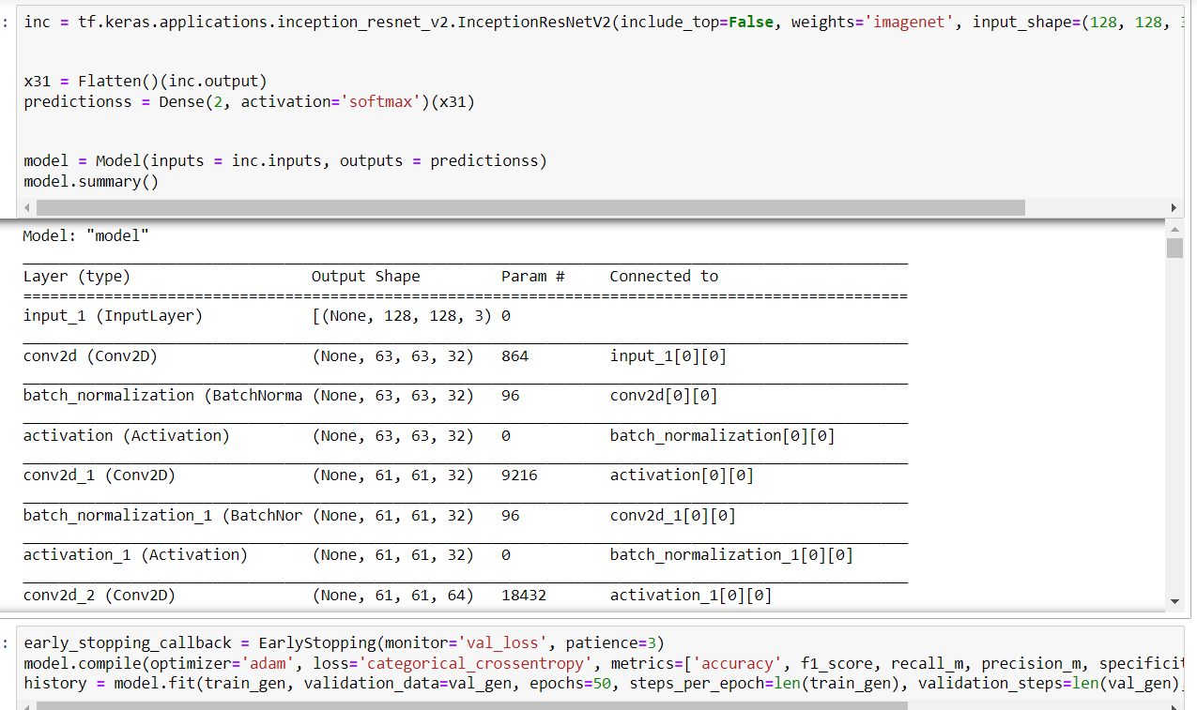
Experiment Screenshots

Slide 12
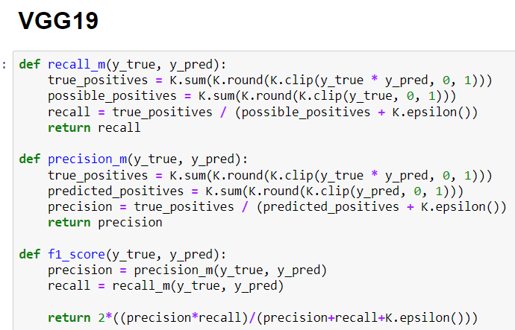
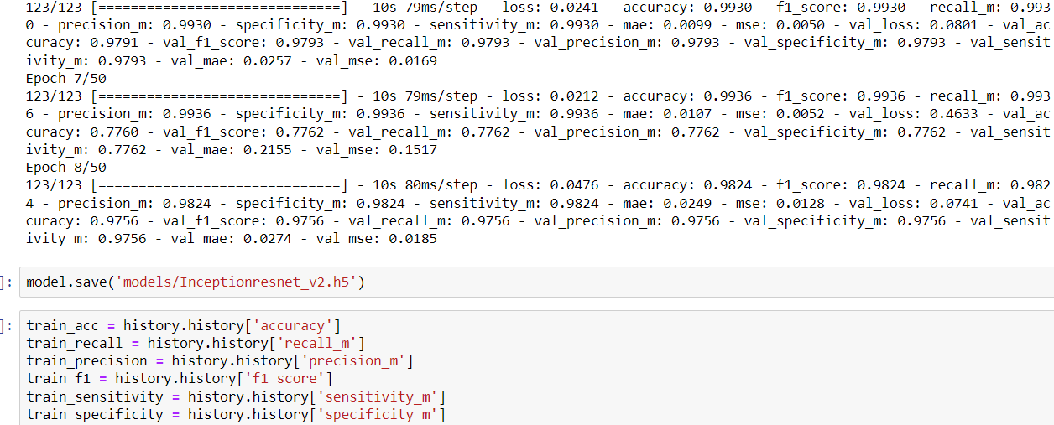
Experiment Screenshots

Slide 13
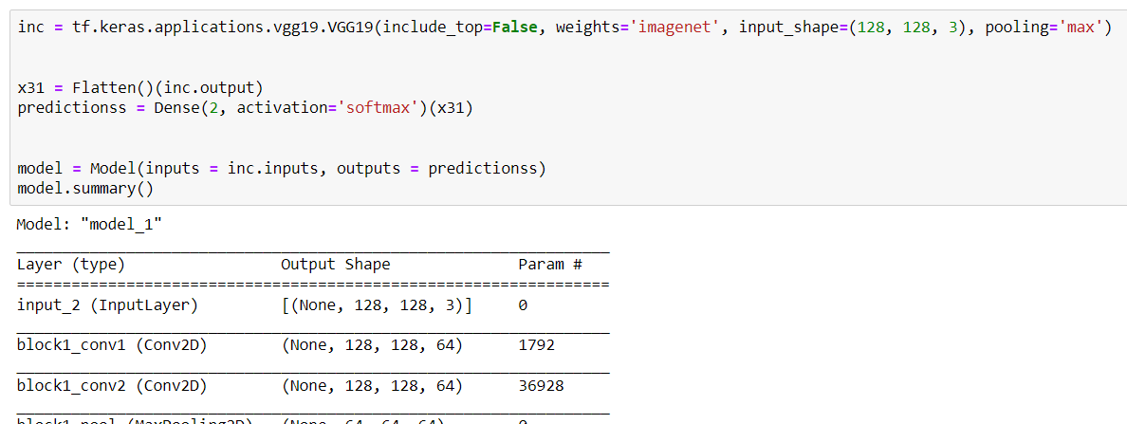
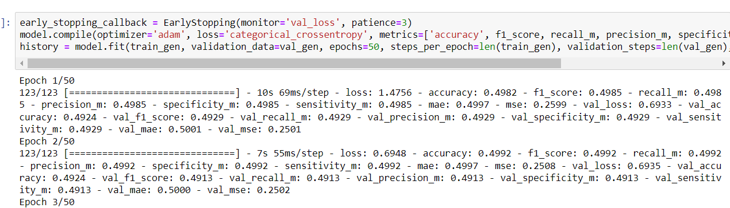
Experiment Screenshots

Slide 14
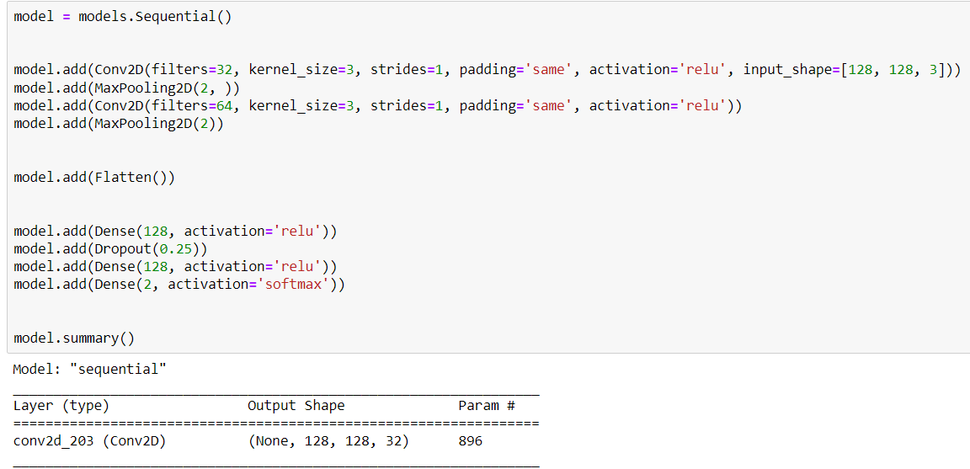
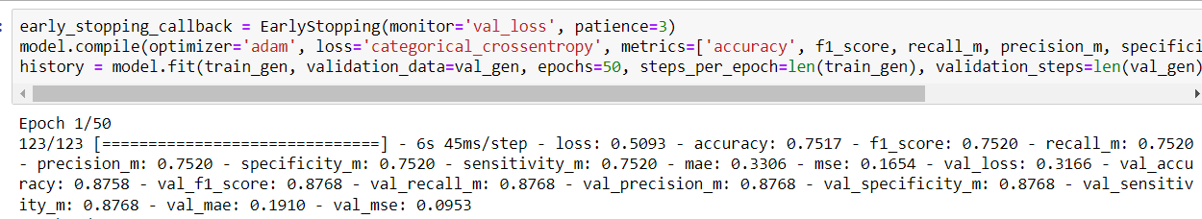
Experiment Screenshots
CNN

Slide 15
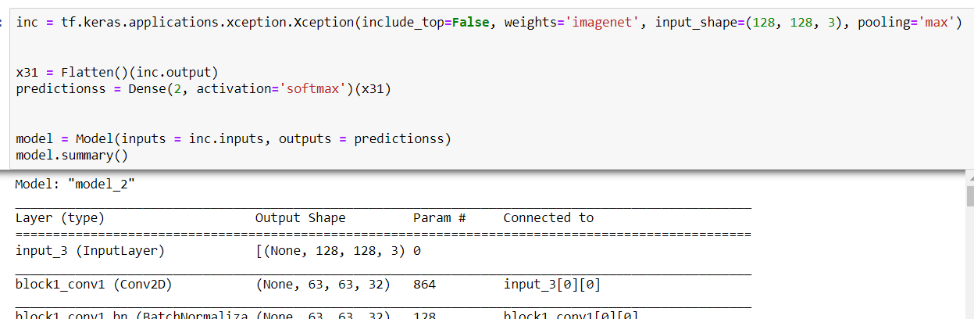
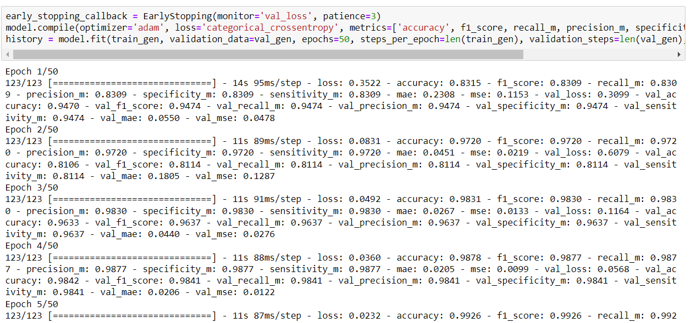
Experiment Screenshots
Xception

Slide 16
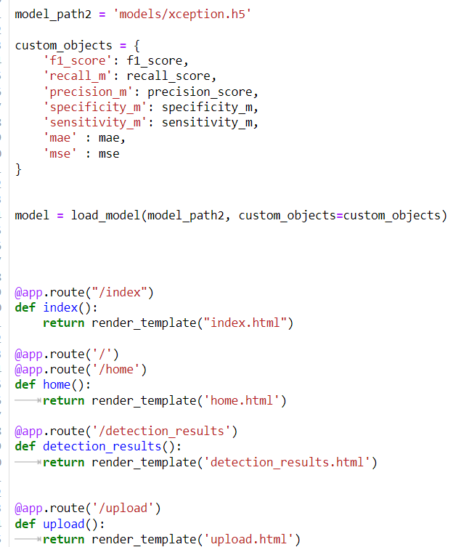
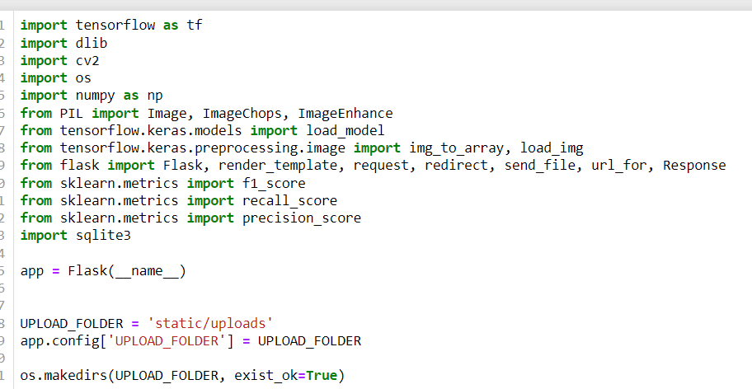
Experiment Screenshots

Slide 17
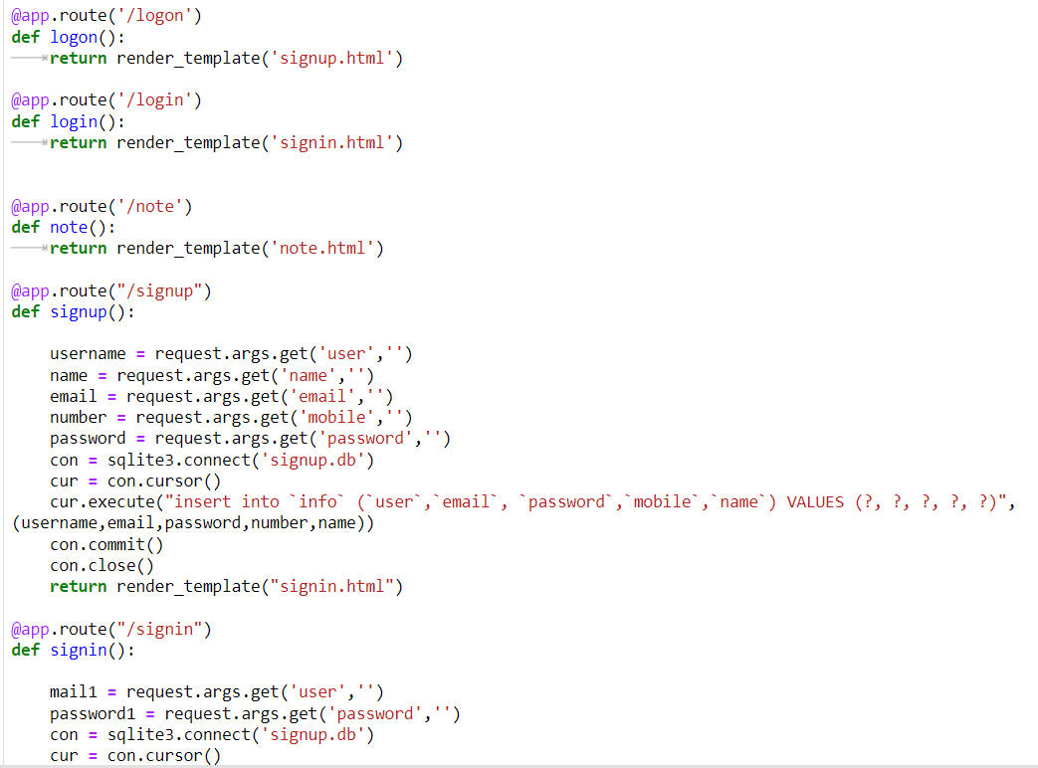
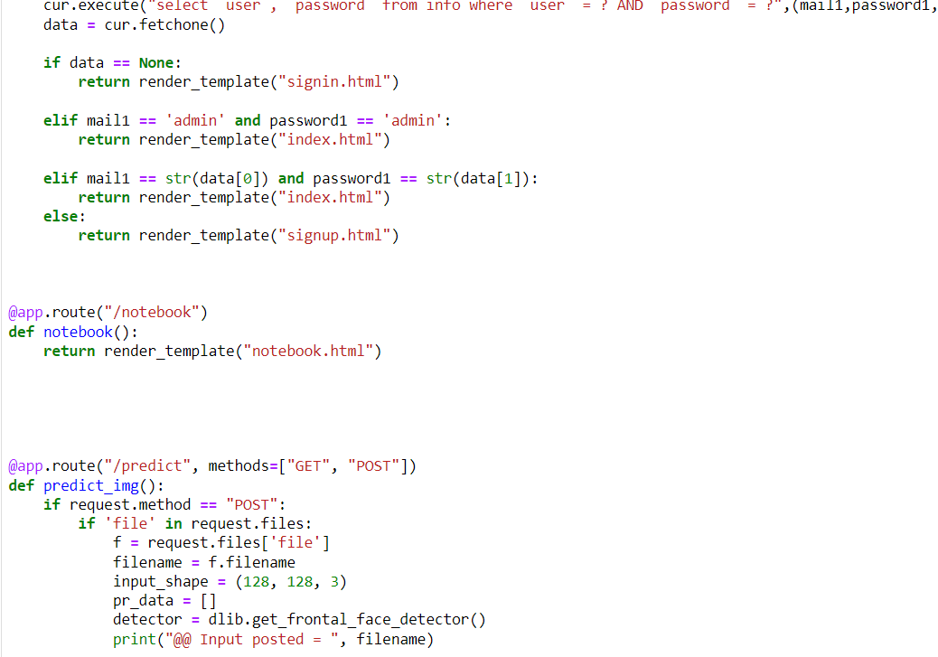
Experiment Screenshots

Slide 18
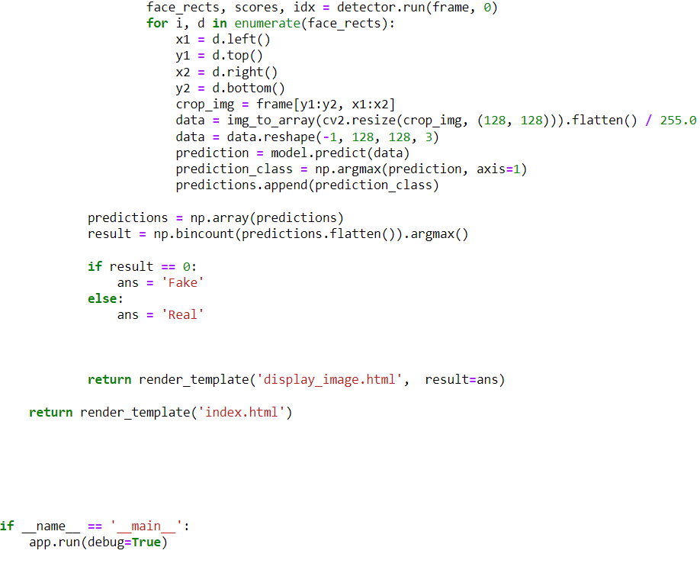
Experiment Screenshots

Slide 19
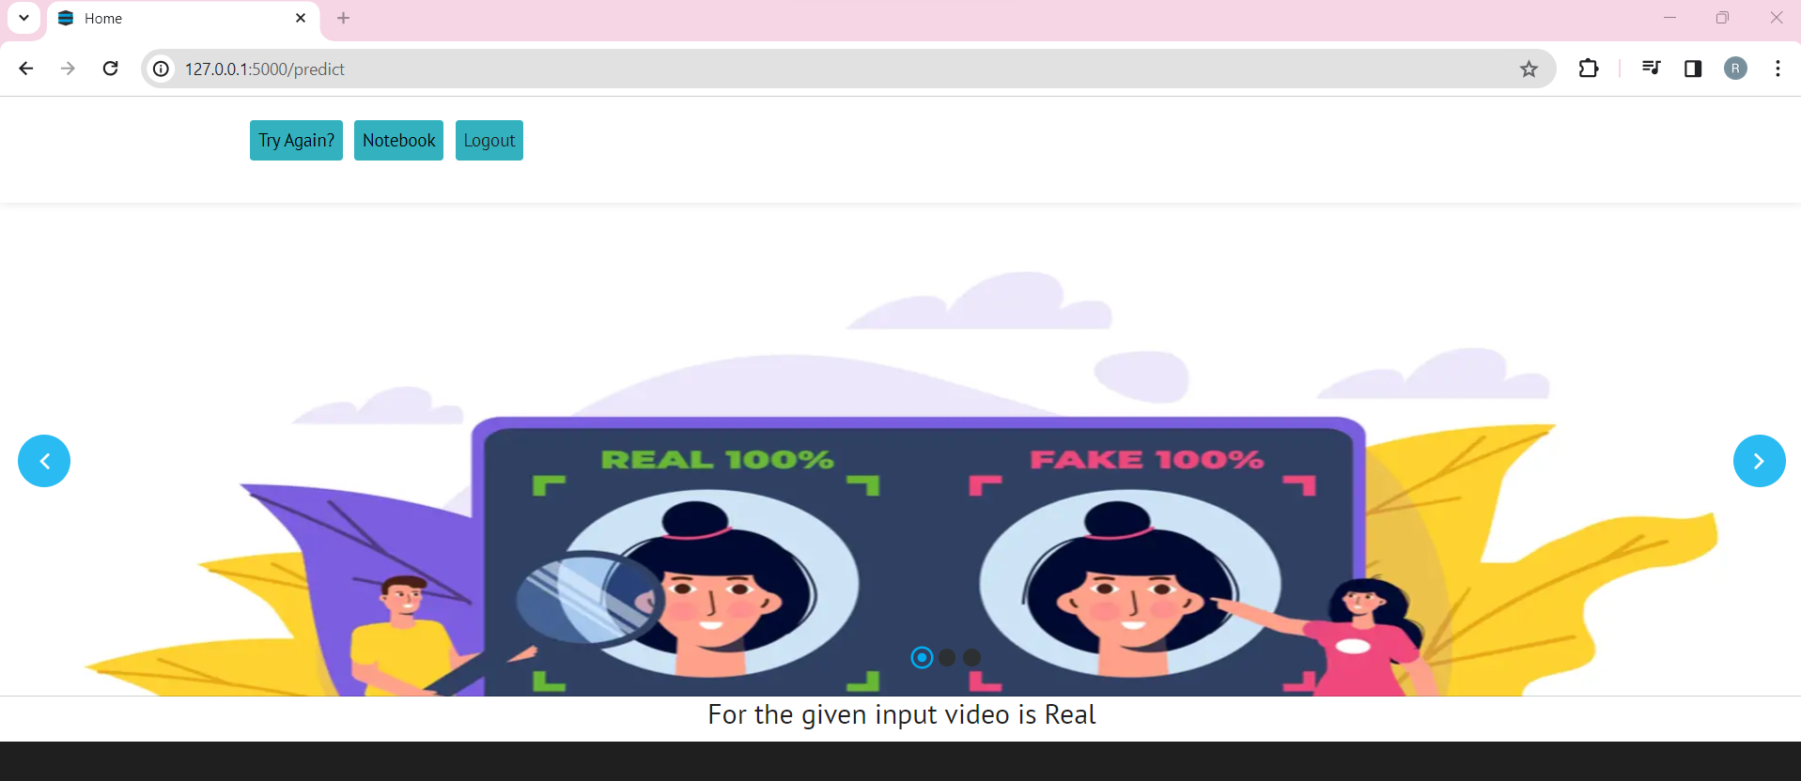
Experiment Results

Slide 20
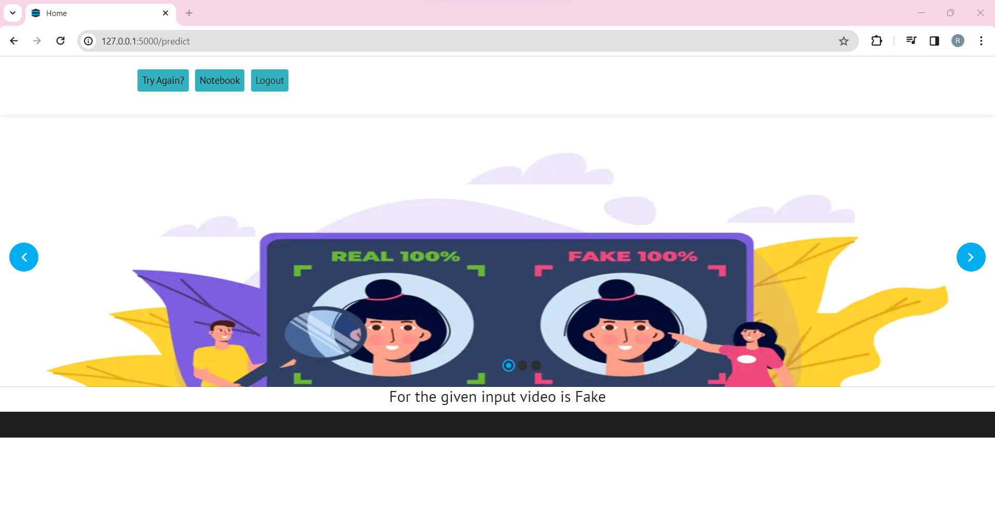
Experiment Results

Slide 21
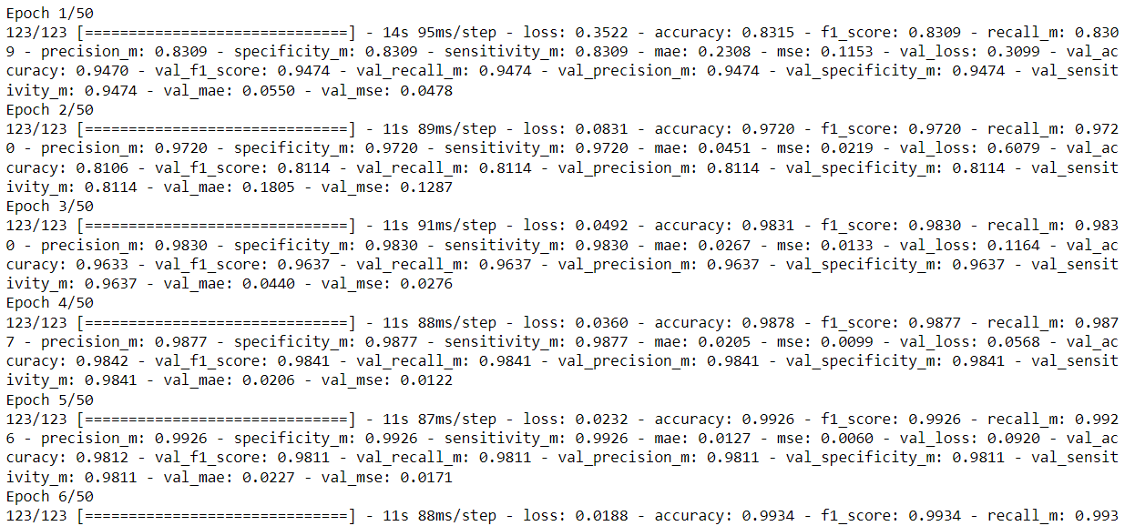
Finding
While detecting the video which is deep fake face mask video or real video using 4 types of algorithms they are VGG19, Inception Resnet V2, CNN, Xception. Among them using the Xception Model we have got the 98% accuracy

Slide 22
Justification
1.What are parameters improved by your method?
Accuracy
precision
recall
f1score
2. Why your parameter values improved?
Quality of Dataset
EDA
Number of Epochs

Slide 23
Thank You

